Slide 1
Telecom Customer Churn
A strategic analysis to increase customer base &
predict churn rate
Noel Abraham (NGA100020) Ramesh Dasari (RXD210017)
Rohan Srivastava (RXS210007) Saurav Gupta (SXG200009)
Vaibhav Gupta (VXG200039)

Slide 2
NOTE:
The purpose of this presentation is to explain our approach and methodology in way that even a person with basic understanding of data analysis can understand the project. For a more detailed explanation, the report needs to be considered along with the code.

Slide 3
Overview
The Company
Context
Questions answered
A telecommunication, internet and streaming service provider, looking to optimize its business model to retain and increase customer base.
It is much cheaper to retain existing customers than it is to acquire new customers.
Using the concept of churn, and past data, add value to business.
What factors contribute most towards customer churn?
Given a set of demographics, preference and services provided, would a customer churn?

Slide 4
Our Approach
Data Overview and Exploratory Analysis
Inferential/ Predictive Analysis
Recommendations
Diving deep into the data, understanding each features’ impact on churn.
Cleaning the data, and drawing out underlying patterns.
Suggesting & optimizing various classification models.
Studying the importance of features in the models.
Comparing the performance of various models based not how well they predict customer churn
Based on the data and our analysis, suggesting actionable insights to increase the customer base.

Slide 5
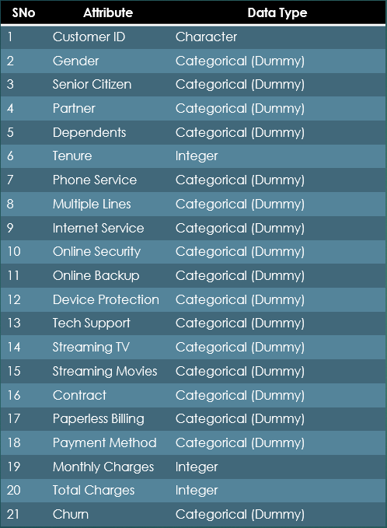
Data Overview
Data Source : https://www.kaggle.com/datasets/blastchar/telco-customer-churn
Data Structure :
7043 records, 21 attributes.
Attributes with types

Slide 6
Data Wrangling
Feature ‘Customer ID’ dropped as it hold no significance.
Scaled continuous variables.
Dropped miniscule NA values.
Classified data into groups:
Demographics: Gender, Senior Citizen, Partner etc
Company Observation Data: Tenure, contract, Paperless Billing, Monthly Charges etc
Services: Phone Service, Tech Support, Streaming TV, Streaming Movies etc.
Cleaning the data for robust results

Slide 7
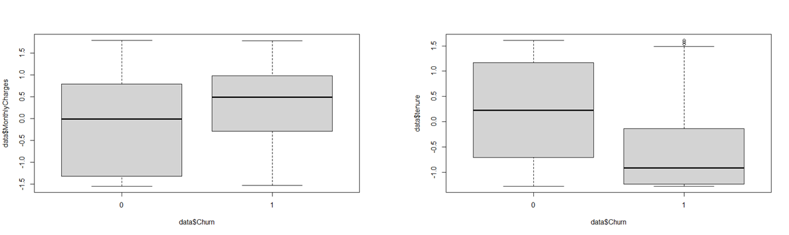
Outliers?
Boxplot of Continuous Variables distribution and their outliers
Very few, not too far out.
Trimming not suggestible due to small sample size and low weightage of outliers

Slide 8
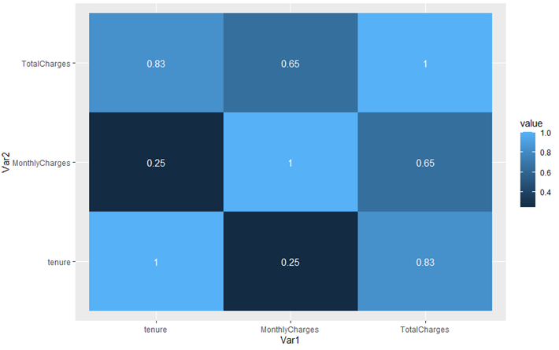
Collerations?
Heat Map: Continuous Variables
Total Charges highly correlated to both Monthly Charges and Tenure.
Considered dropping Total charges.

Slide 9
Exploratory Analysis
Discovering patterns & spotting anomalies using statistics & graphics

Slide 10
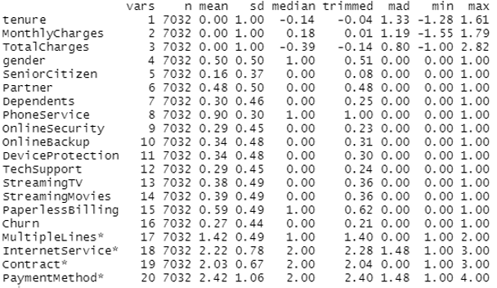
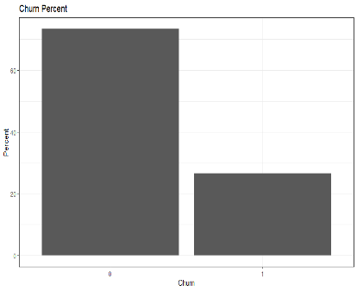
Purpose: To ensure validate the results produced & ensure relevance to business outcomes and goals.
Customer churn rate on an average: 26%.
This 26% is our target market and to increase profits, we must assuage this portion of the population set.
Data Summary
Customer Distribution by Churn percentage

Slide 11
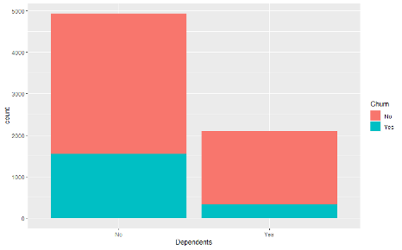
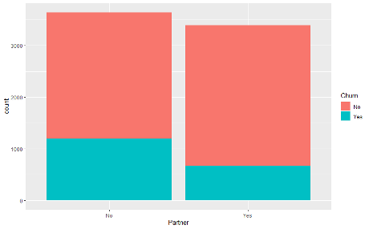
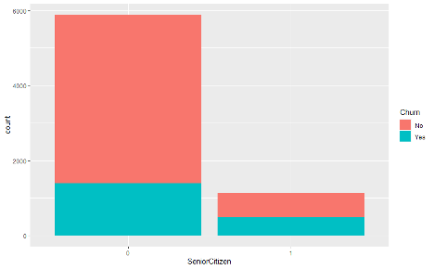
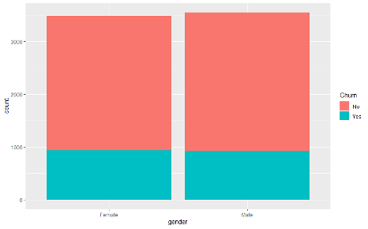
The market mainly comprises of people without dependents and who are not senior citizens.
Churn rate for both these categories is comparatively higher and would probably be a good predictor in defining churn.
Gender seems to play no role in deciding the churn rate as the distribution is uniform even within groups.
Gender might not be a good predictor for analyzing churn rate.
Dependents Churn Dist. Partner Churn Dist.
Senior Citizen Churn Dist. Gender Churn Dist.

Slide 12
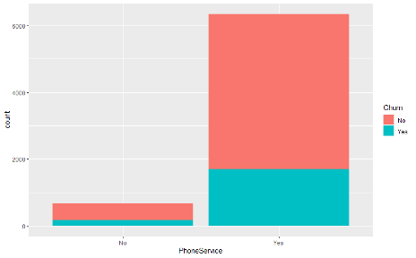
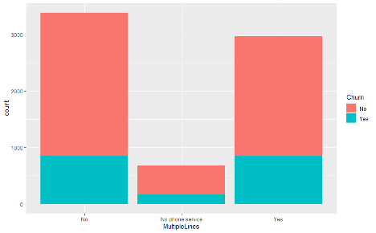
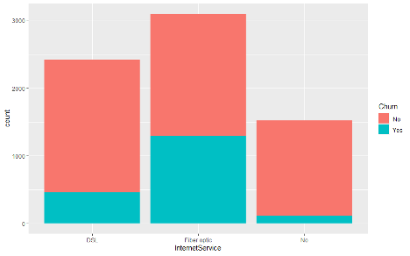
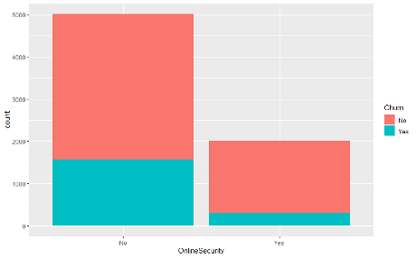
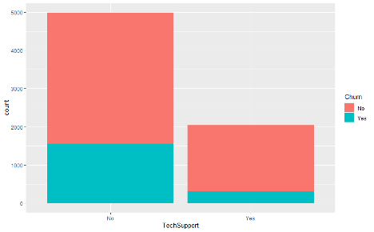
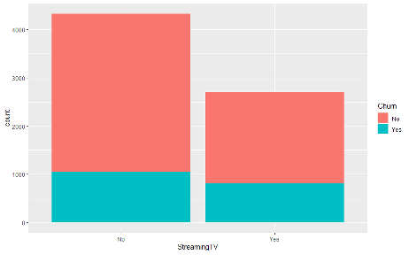
Phone services taken by majority of the people, 25% of them lost due to churn.
Most people opt out of online security, churn rate higher when without security. The company could reduce the cost of online security and make it mandatory for all customers.
Similar pattern for Tech Support.
More Churn when streaming services taken, therefore, can improve the quality of streaming services.
Churn higher when the monthly charges are high
New customers churn out more.

Slide 13
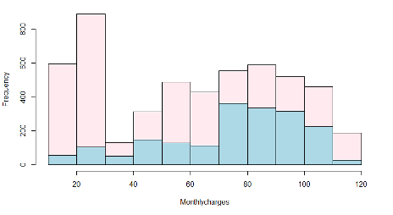
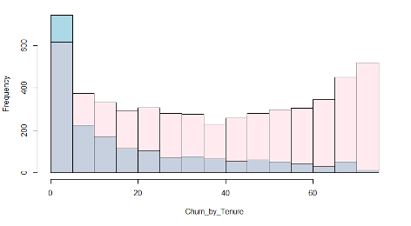
Churn rate higher for high monthly charges & new customer.
The most relevant attributes: Contract, Online Security, Tech Support, Internet Services
Least significant: Gender, Partner, Streaming Service.
We expect these attributes to be discriminative in our future models.
Churn Rate by Monthly Charges
Churn Rate by Tenure

Slide 14
Predictive & Inferential Analysis
To accurately & reliably predict customer churn, we need to implement predictive models.
Data formatted as dependent variable explained by continuous & categorical variables.
Therefore, churn estimated using the models: Logistic regression, Probit regression & Random Forest.

Slide 15
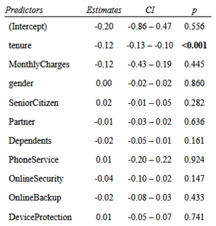
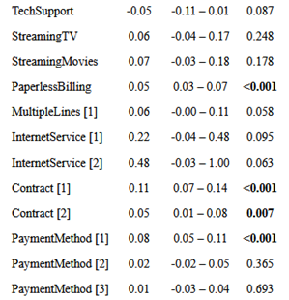
Logistic Regression
Estimating a naive model with of all the variables to get a general idea.
Significance scores not ideal.
AIC score (4339) reported.
Expected as the model may be suffering from multicollinearity and other issues.

Slide 16
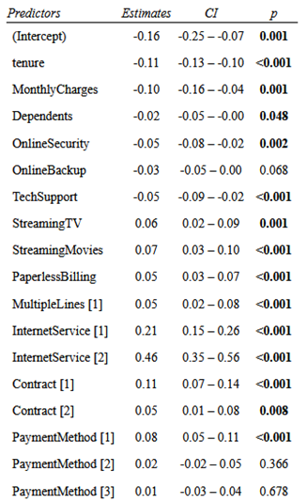
Logistic Regression
Estimating a model based on Step AIC.
Significance scores better.
AIC score (4330) reported, also improved.
Even though AIC is lower, this approach is not reliable as it may remove important features, and lead to omitted variable bias.

Slide 17
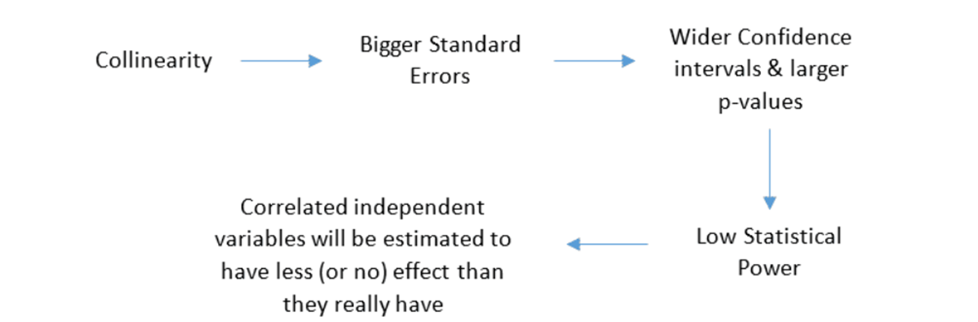
Collinearity
The features might suffer from multicollinearity causing unstable estimates and inaccurate variances. VIF scores for each feature in each model estimated.

Slide 18
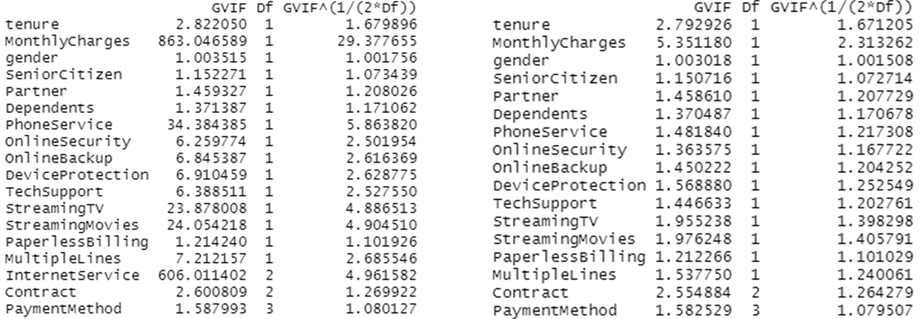
VIF score comparison
VIF Scores Pre-Feature Omit VIF Scores Post-Feature Omit

Slide 19
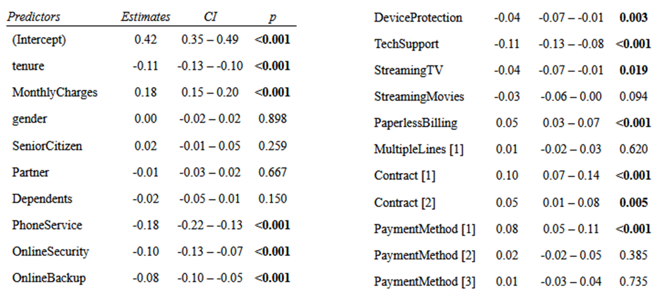
Proposed Logistic Model
Dropping one variable at a time to achieve the least AIC and with no VIF score beyond the cutoff threshold.

Slide 20
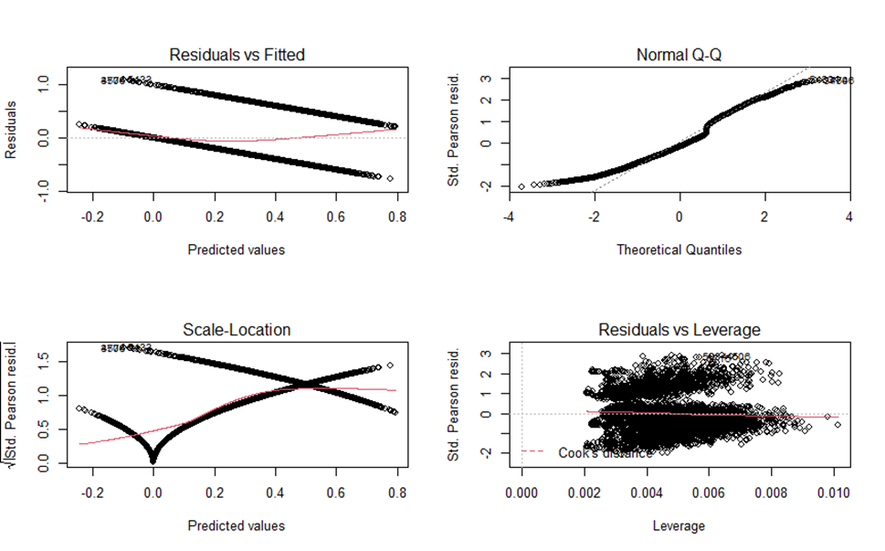
Proposed Logistic Model
Residual Plot for Proposed Logistic Regression

Slide 21
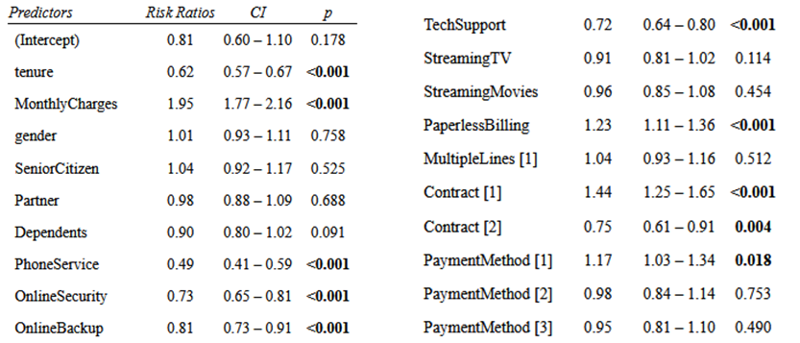
Probit Regression
Estimates of the Probit model with the proposed Features.
The reported AIC score of this model: 4118.6.

Slide 22
Inferences
Proposed Logistic Regression yields the best results for interpretation of the data. Some actionable insights:
Features: Tenure, Monthly charge, Phone Service, Online Security, Online Backup, Device Protection, Tech Support, Paperless Billing highly significant.
Features: Gender and Partner not significant.
Prolonged tenure has positive impact on customer retention.
Features Phone Service, Online Security, Online Backup, Device Protection, Tech Support have positive impact on churn.
People tend to continue with the service less often if offered paperless billing.
Customers opt to continue with the service more if paying annually rather monthly or for two years.
Mailed cheque is the preferred over e-check.
Tenure, Phone service, Online Security and Monthly Charges seem to impact the churn rate the most.

Slide 23
Predicting Customer Churn
Testing various models on their ability to predict churn

Slide 24
Models Implemented for Prediction
Proposed Logistic Regression Model
Proposed Probit Regression Model
Random Forest Model
Random forest is a Supervised Machine Learning Algorithm that builds decision trees on samples and takes their majority vote for classification.
Can handle continuous variables & categorical variables.
Parameters chosen: proximity = FALSE, importance = FALSE, ntree=500, mtry=4.
Random Forest solves the problem of overfitting, is immune to the curse of dimensionality. Since each tree does not consider all the attributes, dimensions are reduced.

Slide 25
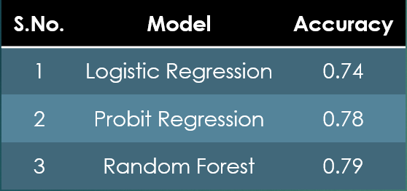
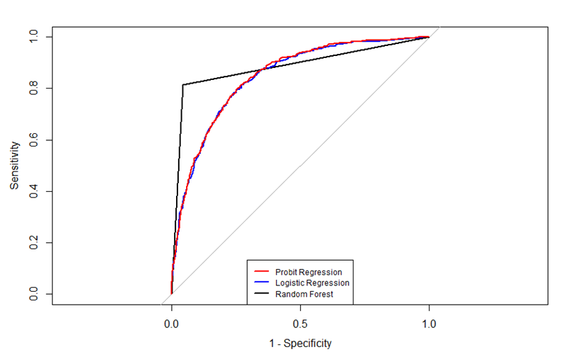
Accuracy & ROC comparison
Random Forest model has the highest accuracy score and the best observed ROC curve
The proposed Random Forest Model would be the best model to predict customer churn.

Slide 26
Summary
Recommendations
26% customer churn rate observed.
Market mainly comprised of people without dependents and who aren’t senior citizens.
Phone service most popular amongst customers.
Having online security led to lower churn.
Most relevant Features: contract, online security, tech support, and internet services
Least significant: Gender, partner, and streaming.
Best model to predict churn : Random Forest
Creating a tiered loyalty program: Customers could progress into higher tiers by subscribing to more services or staying with the company longer. The gamification and marketing of this aspect could increase retention.
Reducing the cost of online security and making it mandatory for all customers.
Discounts on contractual service rather than month to months & additional discount on up front payments for entire contract.
Offering premium quality & speed for high-tier services such as fiber optic and streaming, offering latest hardware to loyal customers.
Improving the customer service quality and speed, minimizing the chain effect of one customer leaving and spreading the word.
Finally, as a last resort, offering incentives to about to churn customers to coerce them to stay (or return).

